Slide 1
CSCE 361: Voting System
Group 9: Cameron Adkins, Yin Po Po Aung, Vittoria Quaranta, Sowparnika Sandhya

Slide 2
Agenda
Group 9: Cameron Adkins, Yin Po Po Aung, Vittoria Quaranta, Sowparnika Sandhya. Voting system
Vision and Scope
Architecture
Front end
Backend
Database
Unit testing
CI Pipeline
Diversity

Slide 3
Vision and Scope
Group 9: Cameron Adkins, Yin Po Po Aung, Vittoria Quaranta, Sowparnika Sandhya. Voting system
Requirements:
Electronic voting system usable for future elections
Allows voter to identify themselves through authentication
After voting, the voter can review and change their selections, but they can only vote once per election
Voting system determines winner
Third party can see if a person voted but not who they voted for, that right is reserved only for the voter
System allows an unlimited number of voters to vote from their own computers or from a shared computer at a polling location.
Will deliver:
Voting system that meets all requirements in a GUI
Will not deliver:
Authentication was taken to mean id and password. There is no validating that a person is a citizen who is eligible to vote and who is who they say they are. This is due to security concerns. This meets the project guidelines, but may hinder this from being used in a real election

Slide 4
Architecture
Group 9: Cameron Adkins, Yin Po Po Aung, Vittoria Quaranta, Sowparnika Sandhya. Voting system
Single Responsibility Principle (SRP) – we gave each class one responsibility.
Open Closed Principle (OCP) – we designed the system so new features can be added without modifying existing code.
Liskov Substitution Principle (LSP) – we ensured subclasses can replace their parent classes without breaking functionality.
Interface Segregation Principle (ISP) – we created small, specific interfaces so classes only implement what they actually use.
Dependency Injection Principle (DIP) – we made high-level modules depend on abstractions rather than concrete implementations.

Slide 5
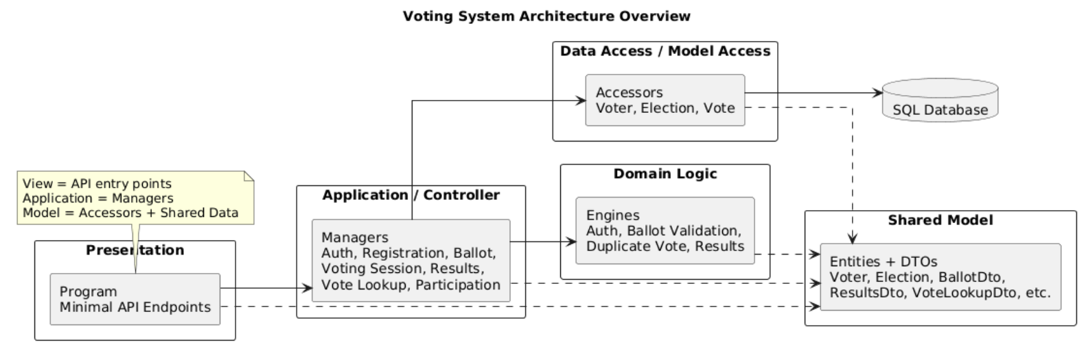
Architecture Diagram

Slide 6
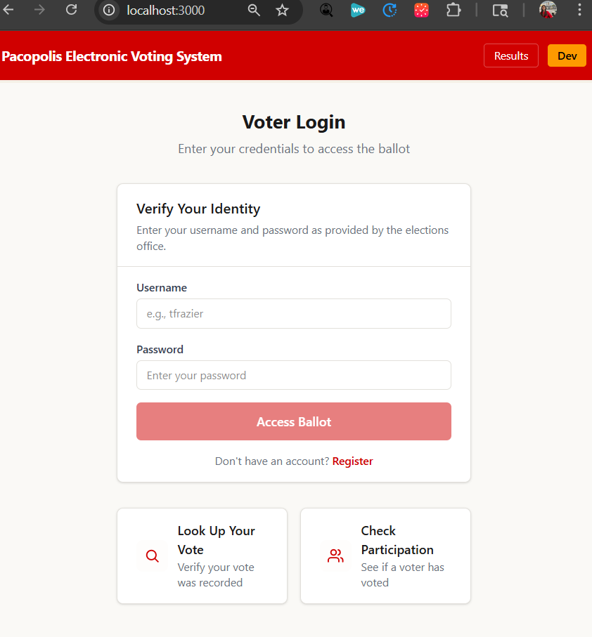
Frontend
Group 9: Cameron Adkins, Yin Po Po Aung, Vittoria Quaranta, Sowparnika Sandhya. Voting system
Technologies: React App (Vite) , CSS
Key User Interfaces
Secure Voter Login
Authenticates votes before access
Ballot Display and Selection
Allow users to make choices
Review and submit
Let users verify their selections before locking them in
Transparency Tools (Lookup & Participation)
Enables voters to securely verify their voting status and ballot
Results
Display the outcome of the results
Notes:
Demo

Slide 7
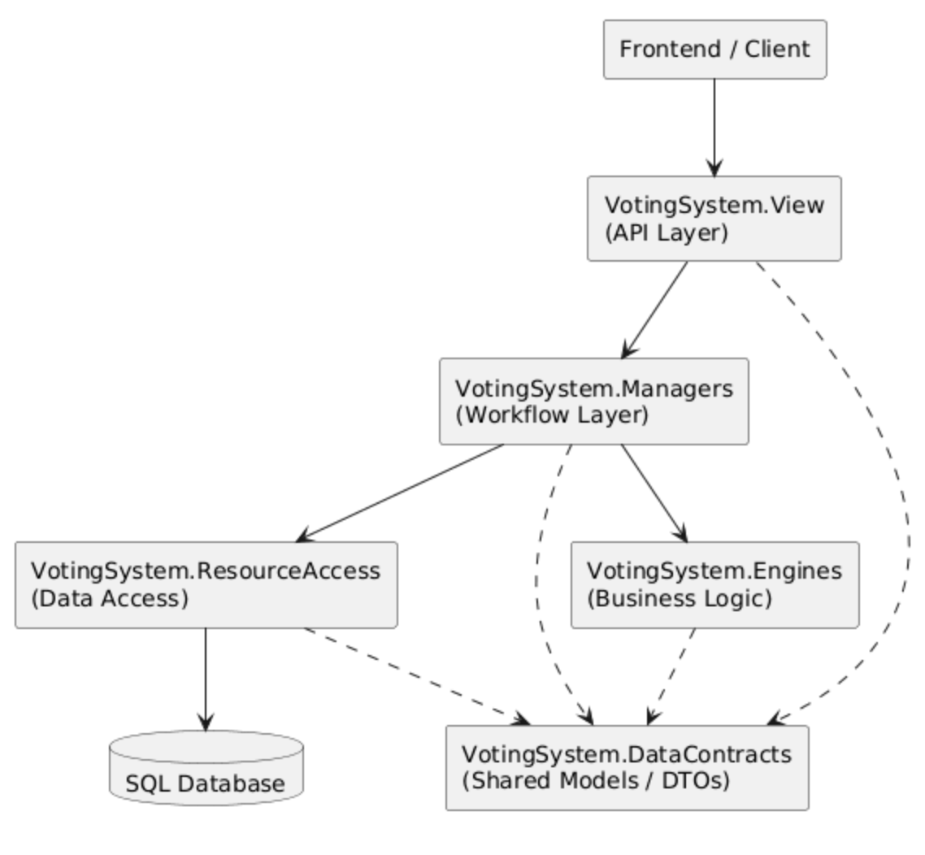
Backend
Group 9: Cameron Adkins, Yin Po Po Aung, Vittoria Quaranta, Sowparnika Sandhya. Voting system
Written in C#
API layer handles incoming requests
Managers coordinate application workflows
Engines enforce core voting logic
ResourceAccess connects to the database
DataContracts share models across layers
Layered design improves maintainability

Slide 8
Database
Group 9: Cameron Adkins, Yin Po Po Aung, Vittoria Quaranta, Sowparnika Sandhya. Voting system
Overview
Built using Azure SQL Database
Designed to ensure security, privacy, and integrity of votes
Separates voter identity from ballot selections
Core Tables
Voter | Stores user info; ensures secure authentication
Election | Defines election period and status
Race | Represents positions; supports both Candidate and Yes/No types
Candidate | Lists all candidates or option for each race

Slide 9
Unit testing
Group 9: Cameron Adkins, Yin Po Po Aung, Vittoria Quaranta, Sowparnika Sandhya. Voting system
Backend unit tests are implemented in .NET 8 using MSTest.
Current test suite: 58 tests, all passing locally.
Current measured coverage from the local run:
Managers + Engines: 98.8%
Engines: 100%
Overall Coverage: 81.73%
Coverage is reported by Coverlet.

Slide 10
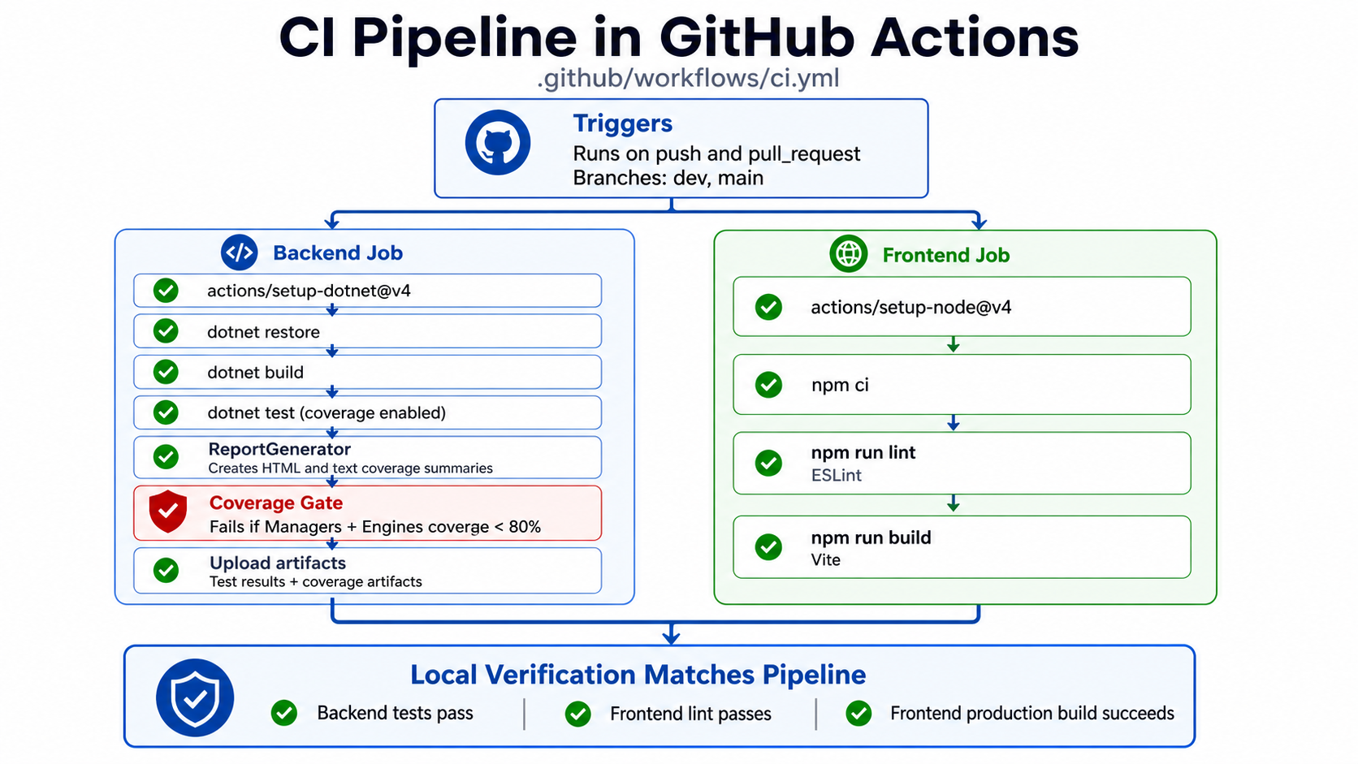

Slide 11
Diversity
Group 9: Cameron Adkins, Yin Po Po Aung, Vittoria Quaranta, Sowparnika Sandhya. Voting system
We had lots of varying skill sets on this project. This allowed us to each use our strengths but also take on new challenges to grow. For example, not everyone in our group had experience working with databases, so they took on more of a front-end role. We were able to collaborate and help each other learn new skills, ranging from improving our Git proficiency to learning new architectures for designing a software engineering project.

Slide 12
Demo
Group 9: Cameron Adkins, Yin Po Po Aung, Vittoria Quaranta, Sowparnika Sandhya. Voting system

